Slide 1
Frequency principle
许志钦
2023年10月2日

Slide 2

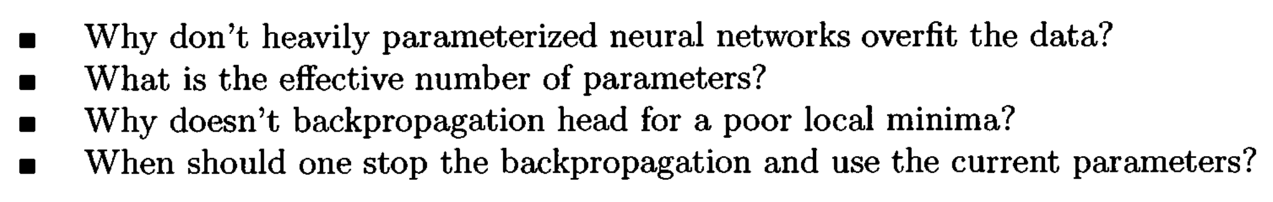
Long-standing problems
1995
Leo Breiman, 1995

Slide 3
Picture of deep learning with implicit bias
loss initialization dynamics
Low frequency interpolations
Linear regime
Non-Linear regime
Nearest
solution
Condensation
Global minima
Parameter space

Slide 4
研究训练过程的意义

Slide 5
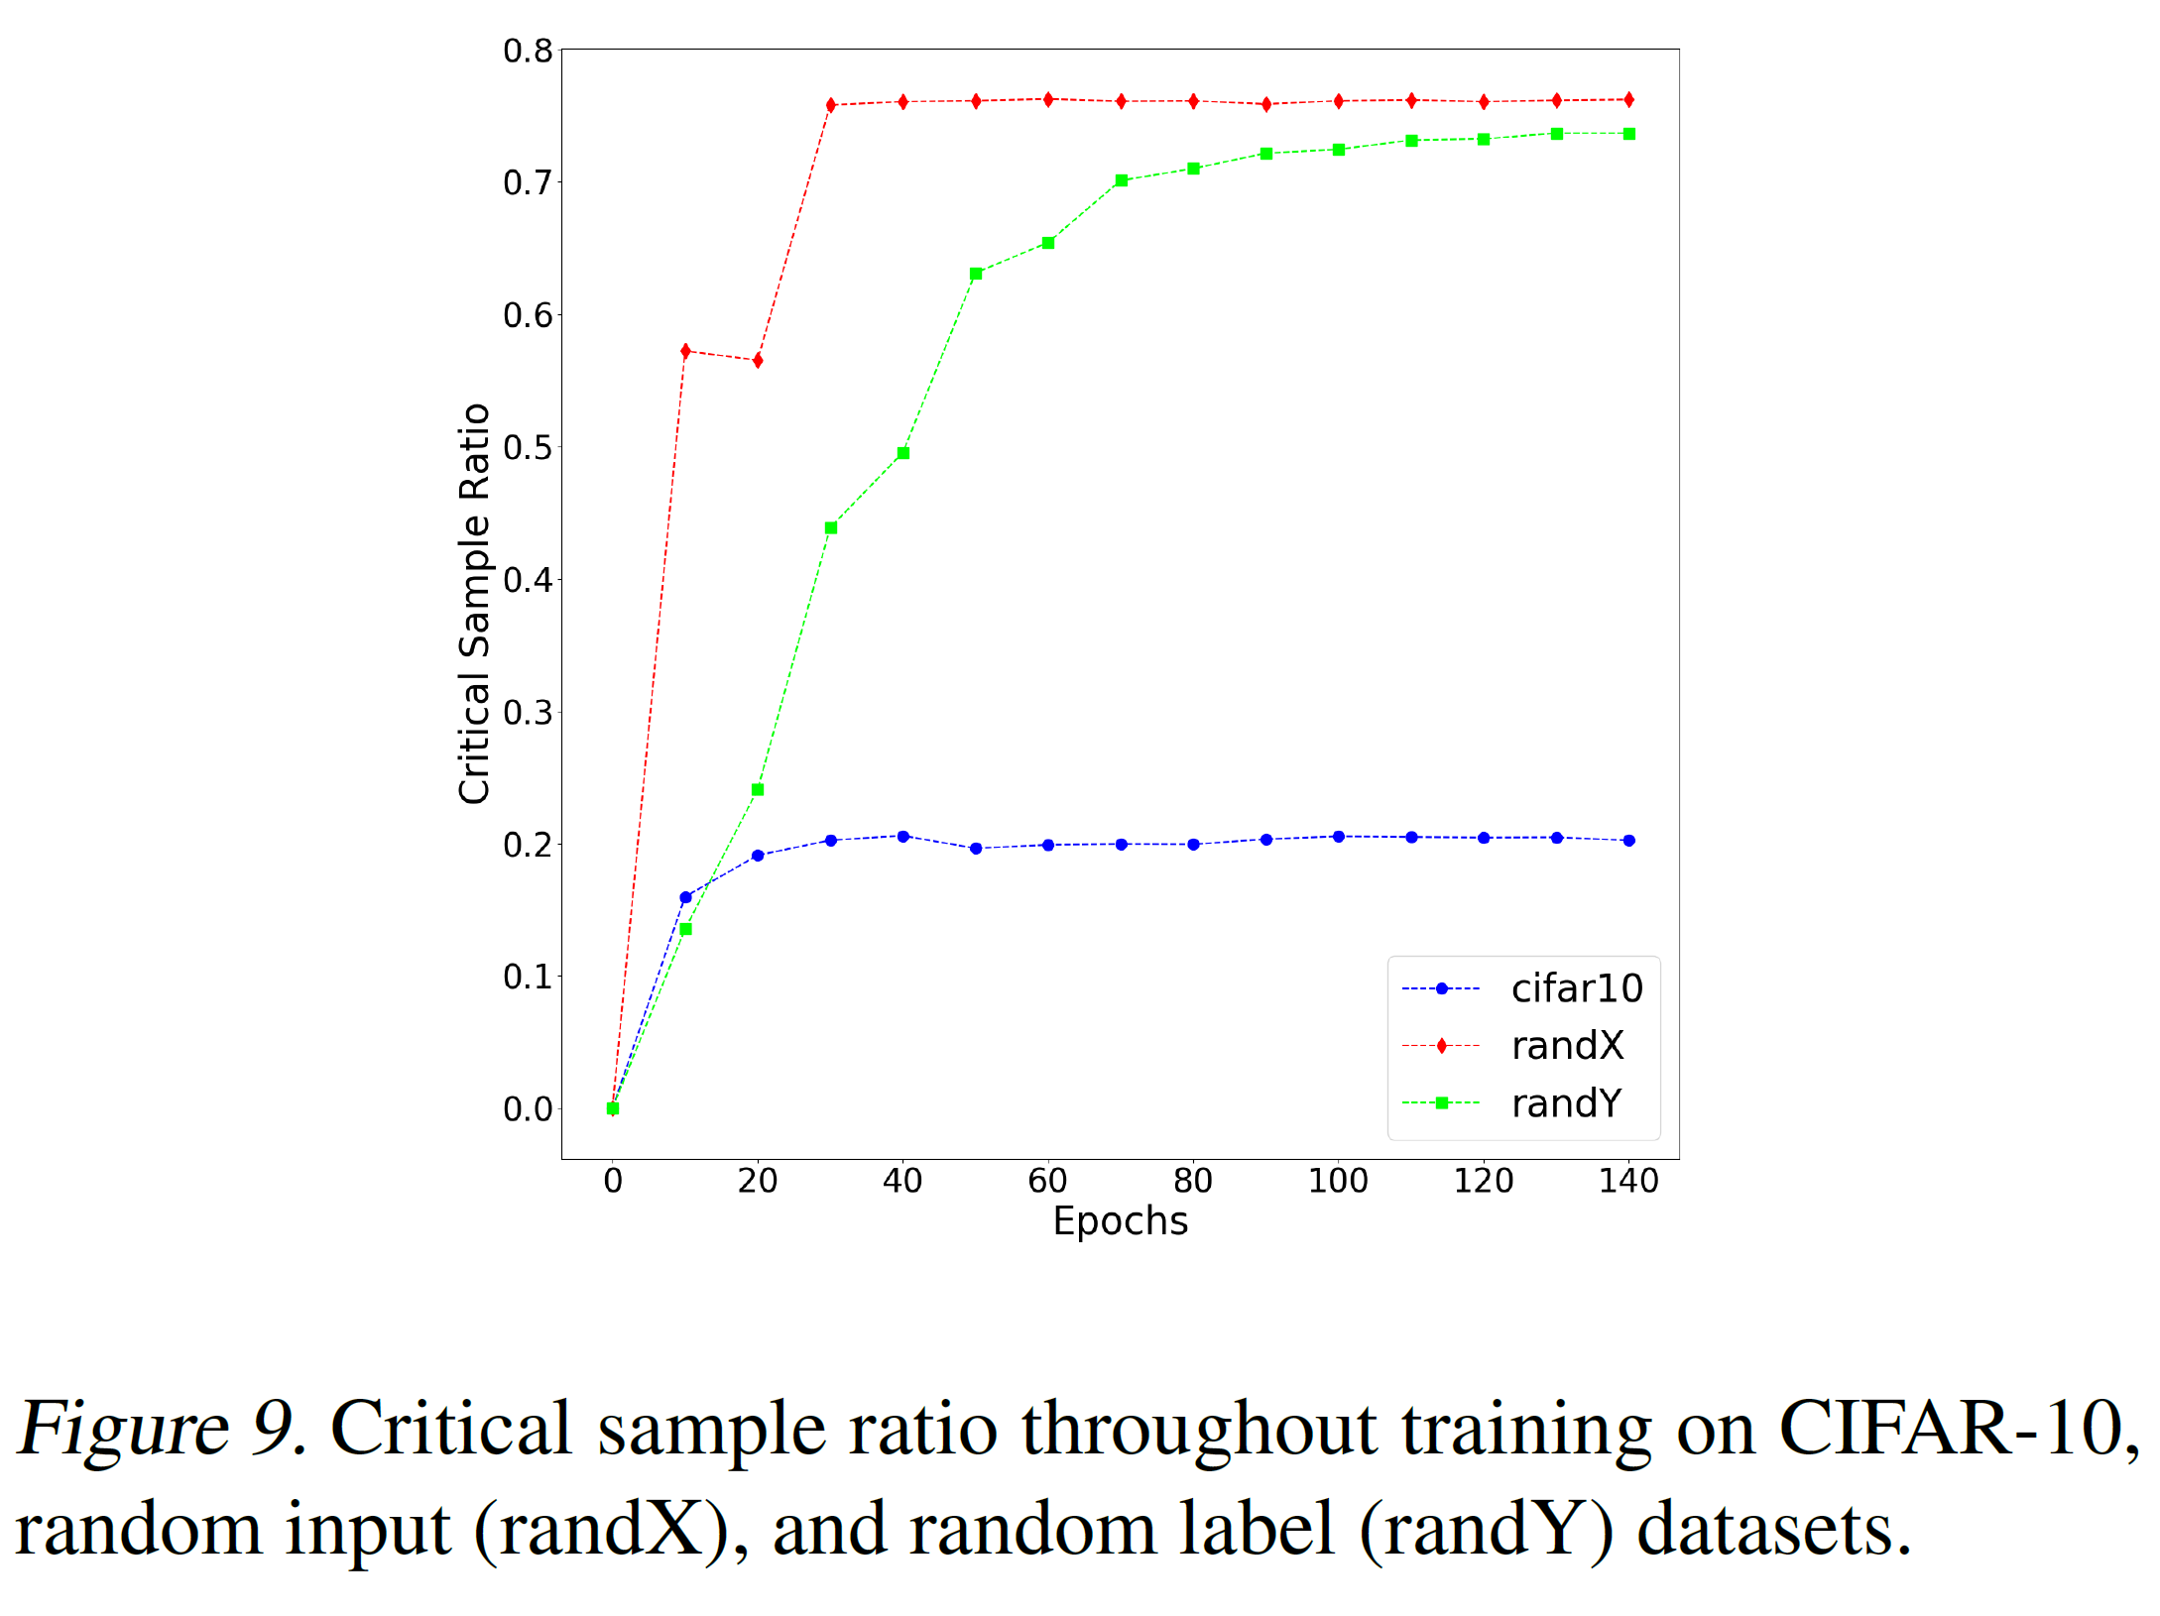
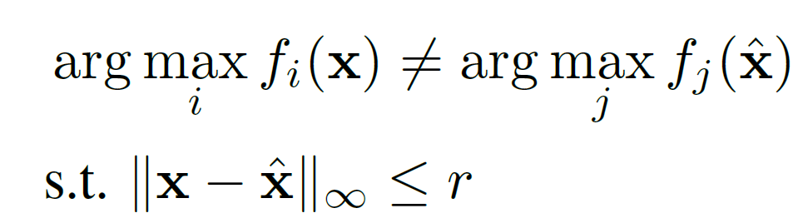
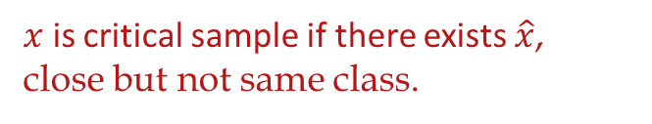
Increasing complexity
$x$ is critical sample if there exists $\hat{x}$,
close but not same class.
Arpit et al., 2017, ICML

Slide 6
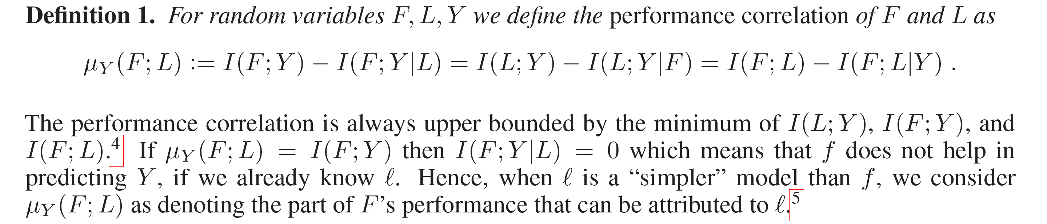
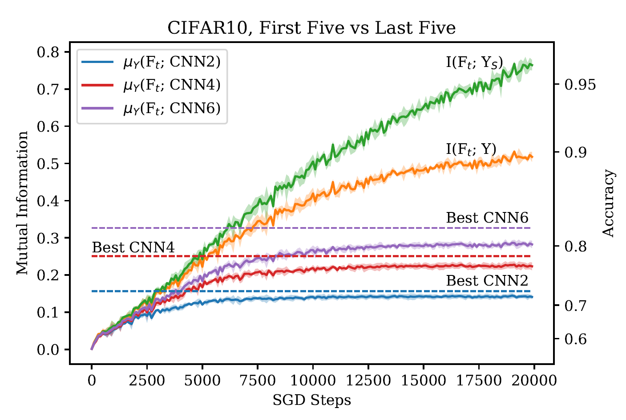
Increasing complexity
Performance correlation
Nakkiran et al., 2019

Slide 7
Why such studies are difficult for understanding DNN?
critical sample is difficult to be analyzed
Performance correlation use black box to characterize black box

Slide 8
低维频率原则实验

Slide 9
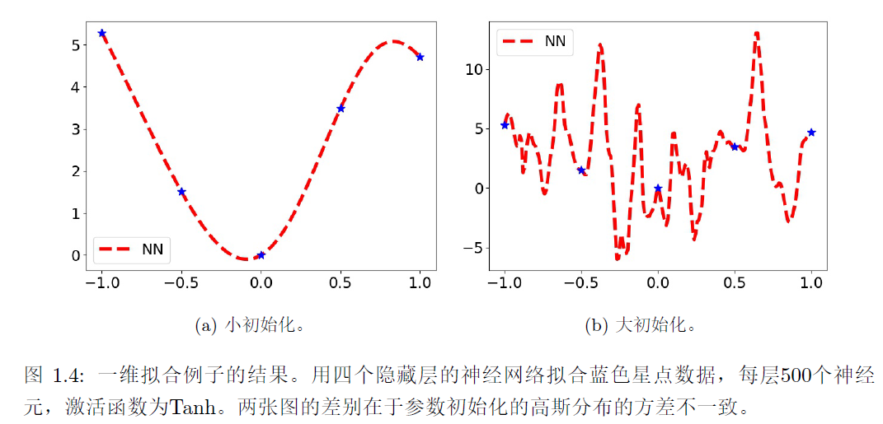
不一样的解

Slide 10
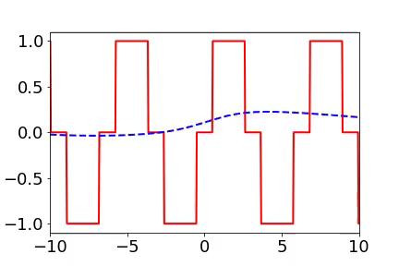
Training process of 1d example in spatial domain
From landscape to detail
Red:
target function
Blue:
DNN fitting
1807.01251

Slide 11
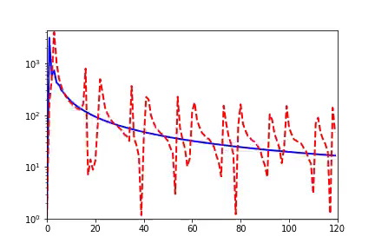
Training process of 1d example in Fourier domain
Frequency principle: From low frequency to high frequency
Red:
target function
Blue:
DNN fitting
Amplitude
Frequency
1807.01251

Slide 12
Training process of 1d example in Fourier domain
Frequency principle: From low frequency to high frequency
Red:
target function
Blue:
DNN fitting
Frequency
Or
Amplitude ?
Amplitude
Frequency
1807.01251

Slide 13
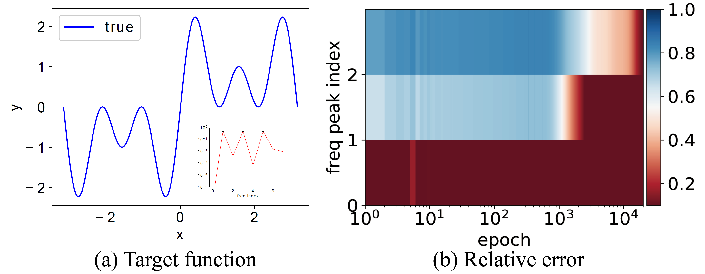
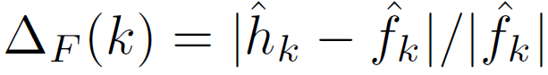
Important problems in this field
Equal amplitudes
$$f\left(x\right)=\sin{x}+\sin{3x}+\sin{5x}$$
1901.06523

Slide 14
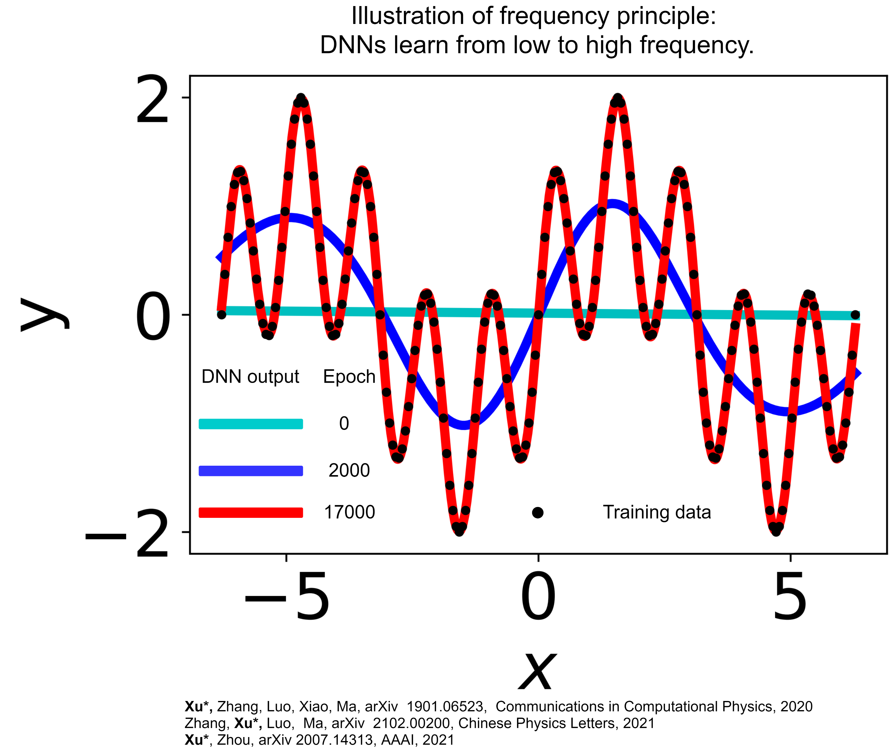
Spatial domain

Slide 15
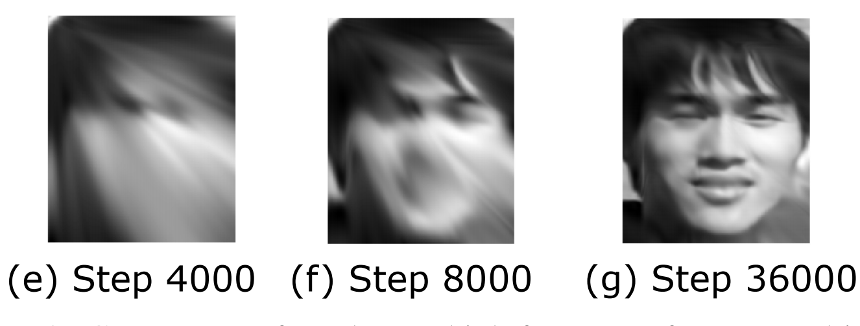
2d data

Slide 16
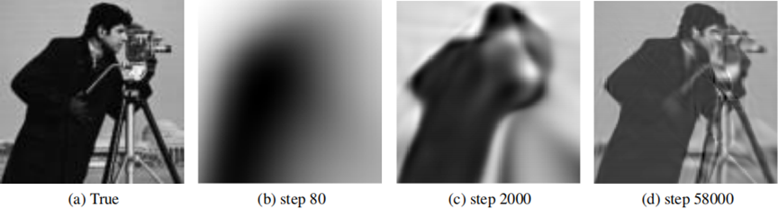
2d data

Slide 17
Difficulty of frequency attracts attention
An important principle for the convergence of the DL networks and PINN networks is the Frequency-principle
Markidis, arxiv: 2103.09655
Recently, frequency analysis on Convolution Neural Networks (CNNs) has attracted more and more attention…
Bin Li et al., arxiv: 2103.11093
In this work, we shall use the F-principle to observe the performance of adaptive activation function
Jagtap and Karniadakis, Journal of Computational Physics, 2020.
Fourier Features Let Networks Learn High Frequency Functions in Low Dimensional Domains
Tancik et al., 2020
……

Slide 18
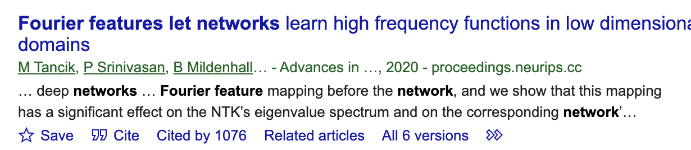
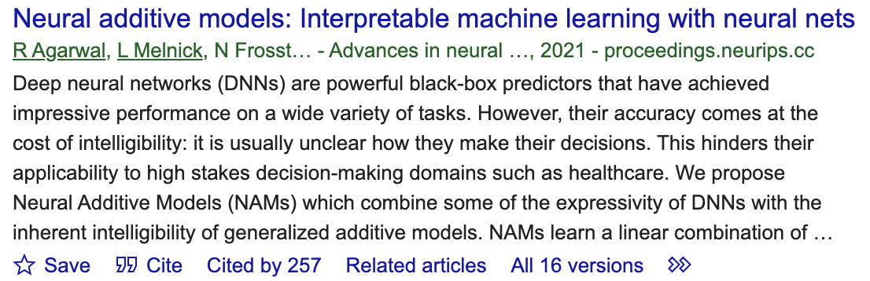
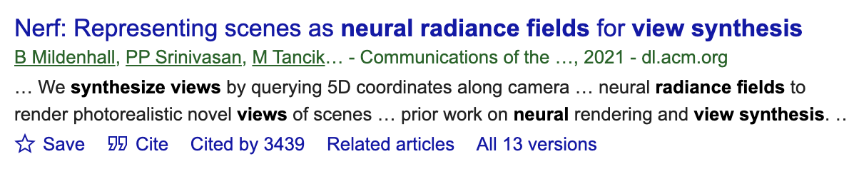
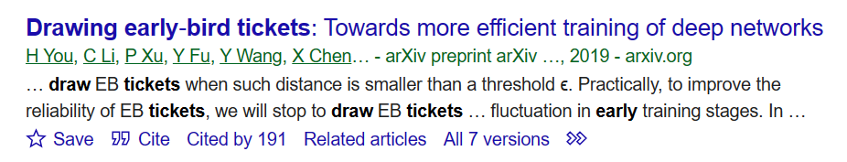
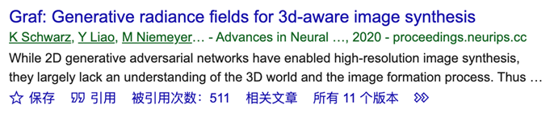
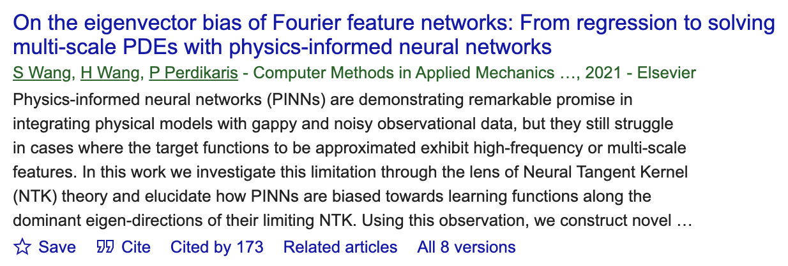
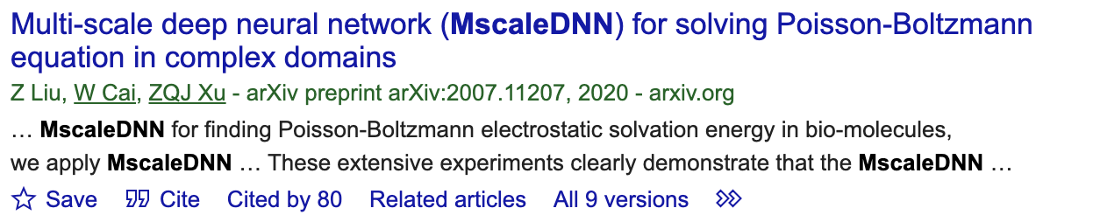
Algorithms inspired by F-Principle

Slide 19
High-dimensional real data?

Slide 20
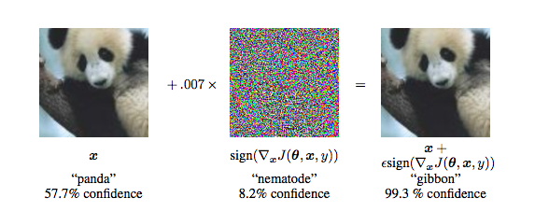
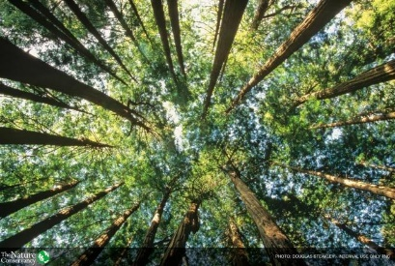
Frequency
Image frequency (not used)
Response frequency
This frequency corresponds to the rate of change of intensity across neighboring pixels.
a general Input-Output mapping f.
High freq： small change of the intensity of the i-th pixel in the image might induce a large change of the output
Zero freq
Same color
high freq
Sharp edge
high freq: Adversarial example
Goodfellow et al.
1901.06523

Slide 21
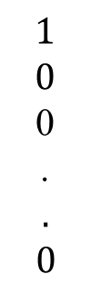
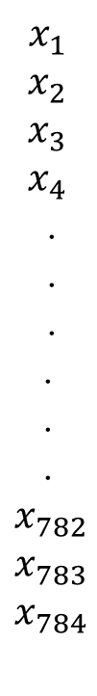
Example of high frequency
$$x_{1}$$
$$x_{2}$$
$$x_{3}$$
$$x_{4}$$
.
.
.
$$\text{.}$$
$$\text{.}$$
$$\text{.}$$
$$x_{782}$$
$$x_{783}$$
$$x_{784}$$
$$1$$
$$0$$
0
.
$$\text{.}$$
$${ 0}_{ }$$
Label
1901.06523
Pixel value

Slide 22


Example of high frequency
$$x_{1}$$
$$x_{2}$$
$$x_{3}$$
$$x_{4}$$
.
.
.
$$\text{.}$$
$$\text{.}$$
$$\text{.}$$
$$x_{782}$$
$$x_{783}$$
$$x_{784}$$
$$δ$$
$$0$$
$$1$$
0
.
$$\text{.}$$
$${ 0}_{ }$$
Label
1901.06523
Pixel value

Slide 23
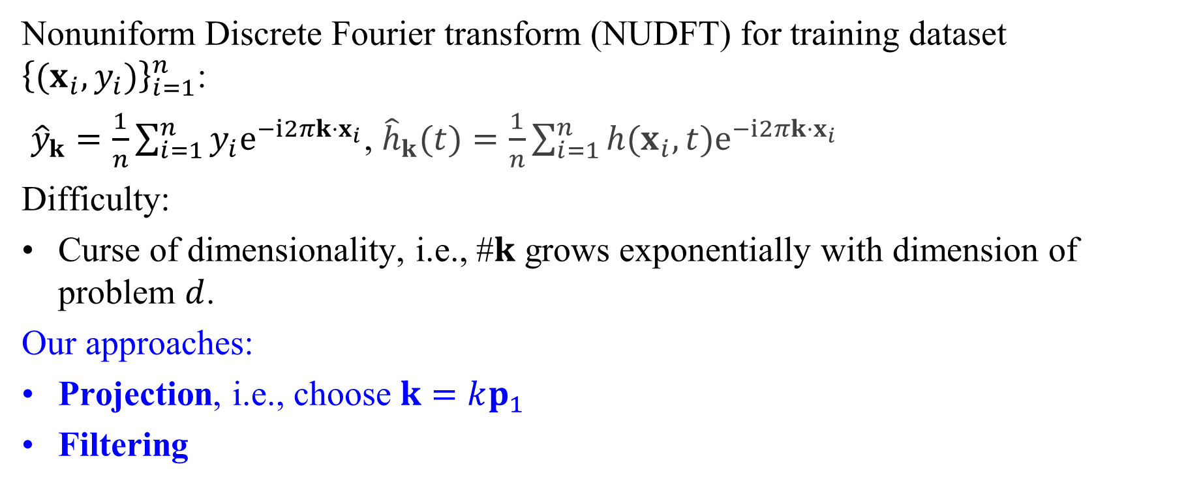
F-Principle in high dimension
Nonuniform Discrete Fourier transform (NUDFT) for training dataset ${\left\{(x_{i},y_{i})\right\}}_{i=1}^{n}$:
${\hat{y}}_{k}=\frac{1}{n}\sum_{i=1}^{n}{y_{i}e^{−i2πk⋅x_{i}}}$, ${\hat{h}}_{k}(t)=\frac{1}{n}\sum_{i=1}^{n}{h(x_{i},t)e^{−i2πk⋅x_{i}}}$
Difficulty:
Curse of dimensionality, i.e., #$k$ grows exponentially with dimension of problem $d$.
Our approaches:
Projection, i.e., choose $k=kp_{1}$
Filtering
1901.06523

Slide 24
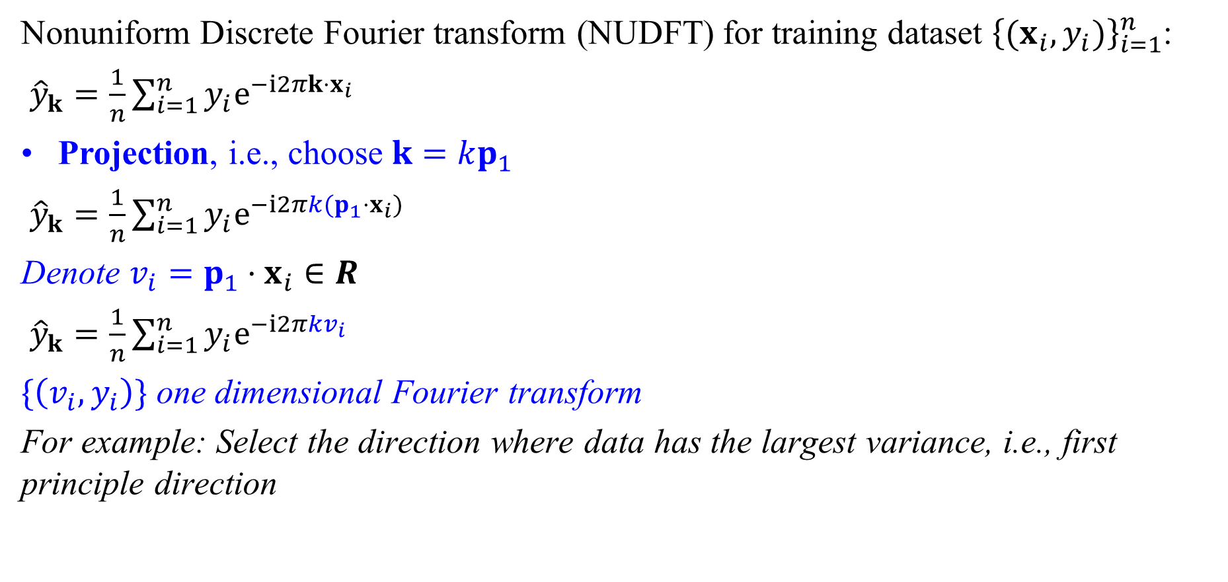
Projection approach to examine F-Principle in H-D
Nonuniform Discrete Fourier transform (NUDFT) for training dataset ${\left\{(x_{i},y_{i})\right\}}_{i=1}^{n}$:
${\hat{y}}_{k}=\frac{1}{n}\sum_{i=1}^{n}{y_{i}e^{−i2πk⋅x_{i}}}$
Projection, i.e., choose $k=kp_{1}$
${\hat{y}}_{k}=\frac{1}{n}\sum_{i=1}^{n}{y_{i}e^{−i2πk{(p}_{1}⋅x_{i})}}$
Denote $v_{i}=p_{1}⋅x_{i}∈R$
${\hat{y}}_{k}=\frac{1}{n}\sum_{i=1}^{n}{y_{i}e^{−i2πkv_{i}}}$
$\{\left(v_{i},y_{i}\right)\}$ one dimensional Fourier transform
For example: Select the direction where data has the largest variance, i.e., first principle direction
1901.06523

Slide 25
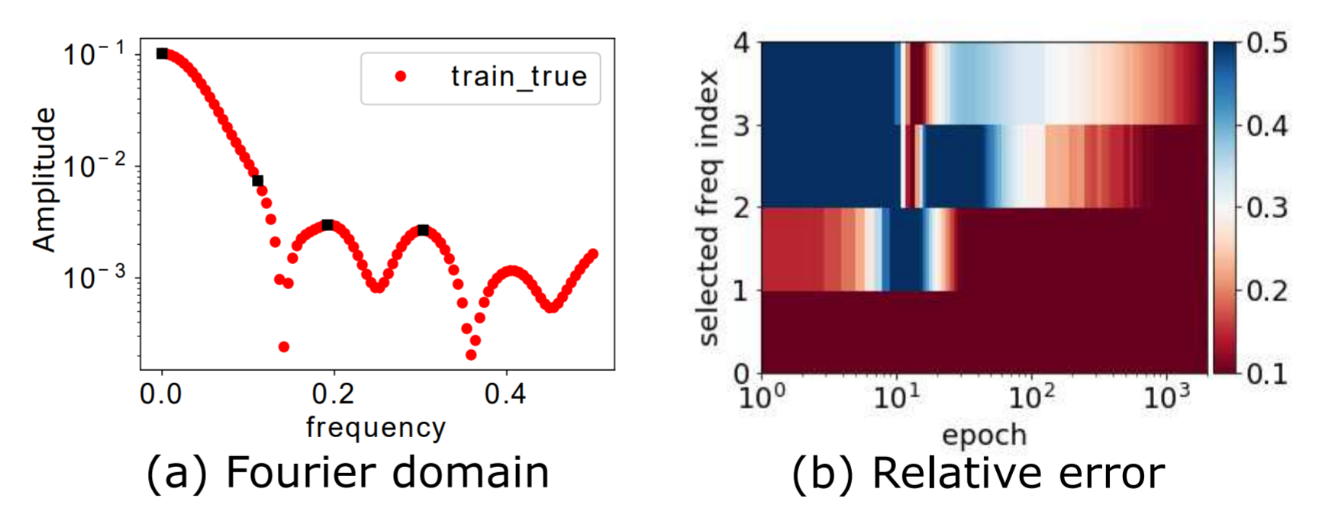
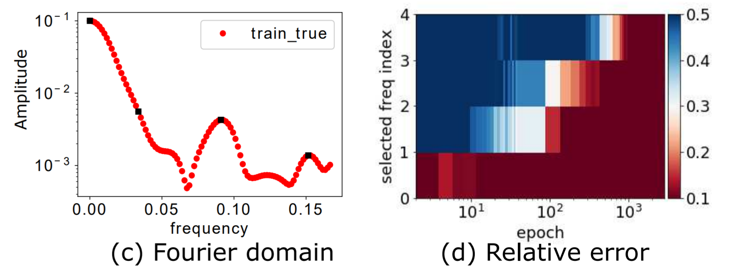

Projection approach to examine F-Principle in H-D
Relative error: $Δ_{F}\left(k\right)=\left|{\hat{h}}_{k}−{\hat{y}}_{k}\right|/|{\hat{y}}_{k}|$
MNIST
CIFAR10
1901.06523

Slide 26



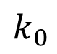
Filtering approach to examine F-Principle in H-D
Product with an indicator function in Fourier space
low-freq of $\hat{y}$
$${\hat{y}}^{low}=\hat{y}⋅I_{\left|k\right|<k_{0}}$$
high-freq of $\hat{y}$
Using Gaussian to approximate indicator function
$$k_{0}$$
1901.06523

Slide 27
Filtering approach to examine F-Principle in H-D
MNIST
CIFAR10
CIFAR10
1901.06523
Xu et al., (2019, 1901.06523)

Slide 28
More Experiments -- High dimensional data -- Non-gradient descent training

Slide 29
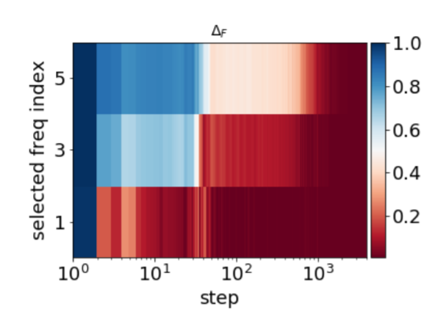
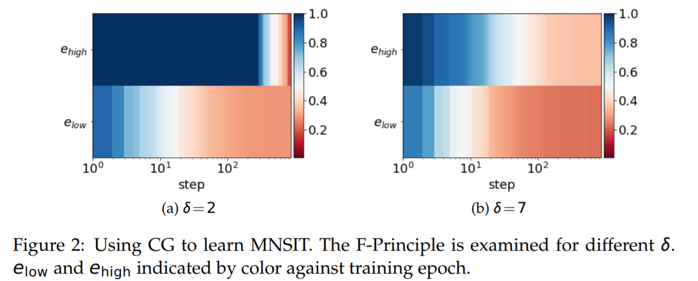
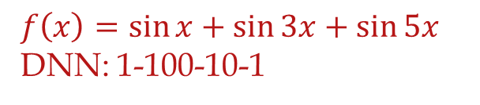
Conjugate Gradient algorithm
$$f\left(x\right)=\sin{x}+\sin{3x}+\sin{5x}$$
DNN: 1-100-10-1
MNIST
DNN: CNN
[14$] Ma, Xu*, Zhang*, 2101.00747

Slide 30
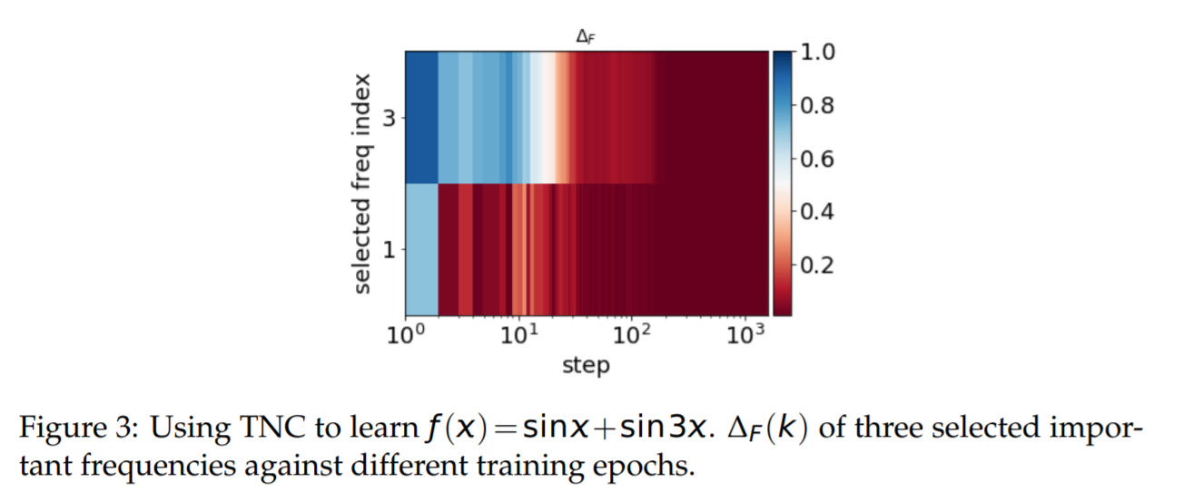
Truncated Newton algorithm
[14$] Ma, Xu*, Zhang*, 2101.00747

Slide 31
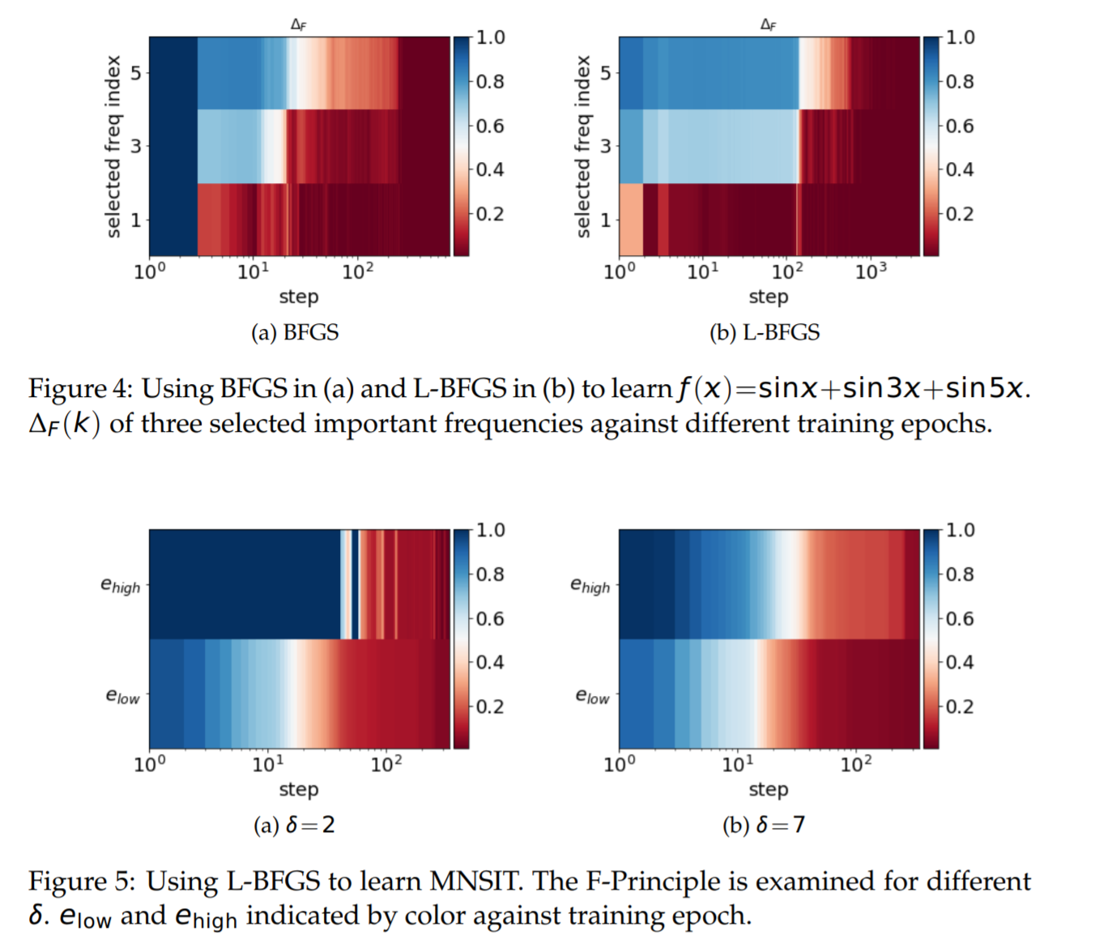
BFGS
[14$] Ma, Xu*, Zhang*, 2101.00747

Slide 32
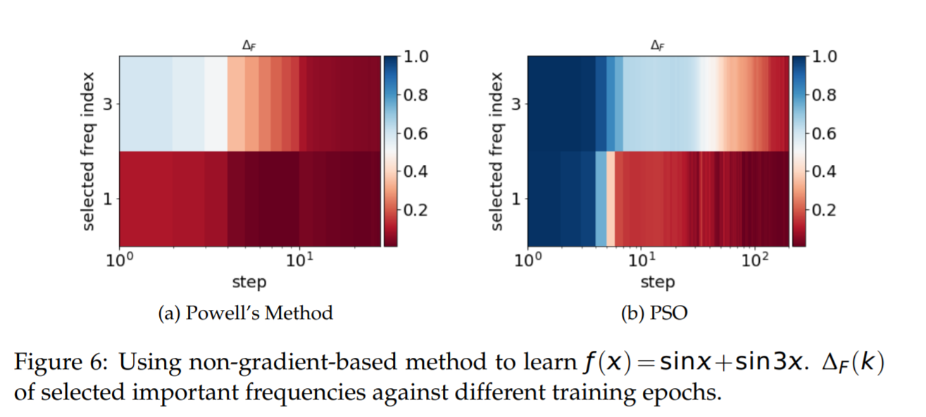
Non-gradient methods
[14$] Ma, Xu*, Zhang*, 2101.00747

Slide 33
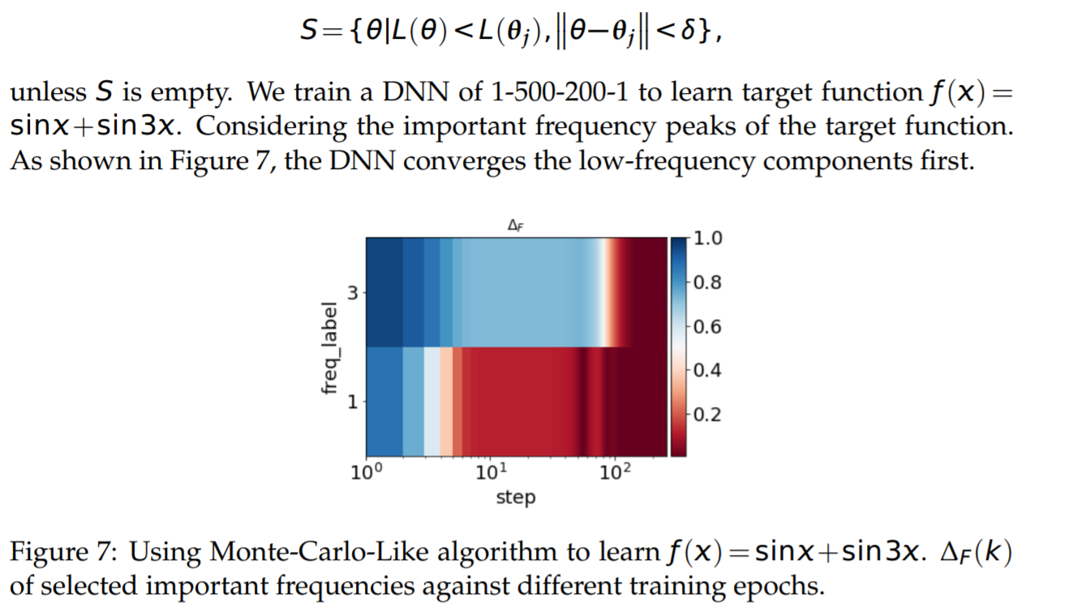
Monte-Carlo-Like algorithm
[14$] Ma, Xu*, Zhang*, 2101.00747

Slide 34
Why frequency principle?
Learn from low to high frequency

Slide 35
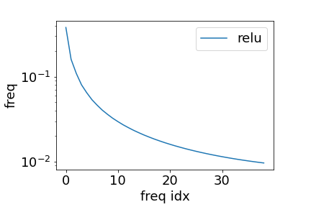
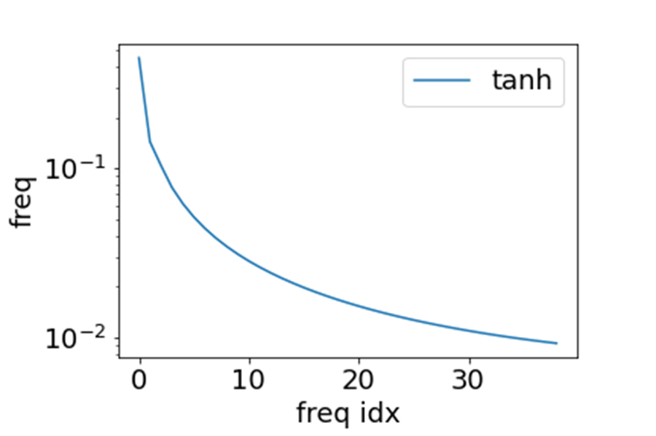
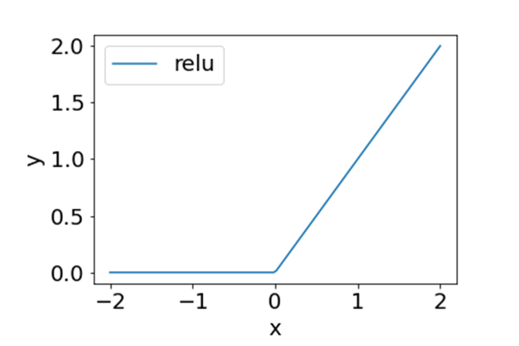
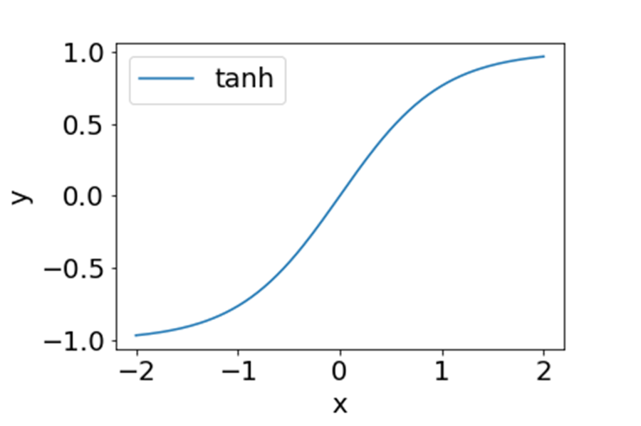
ReLU and Tanh in Fourier domain
Decay with frequency

Slide 36
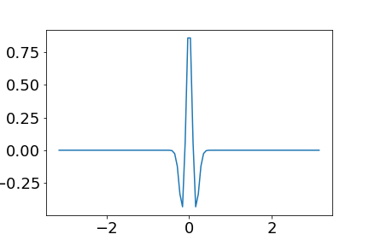
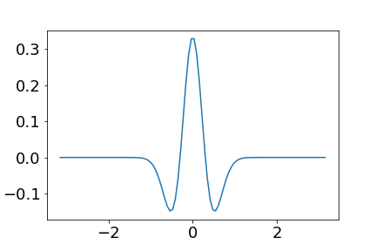
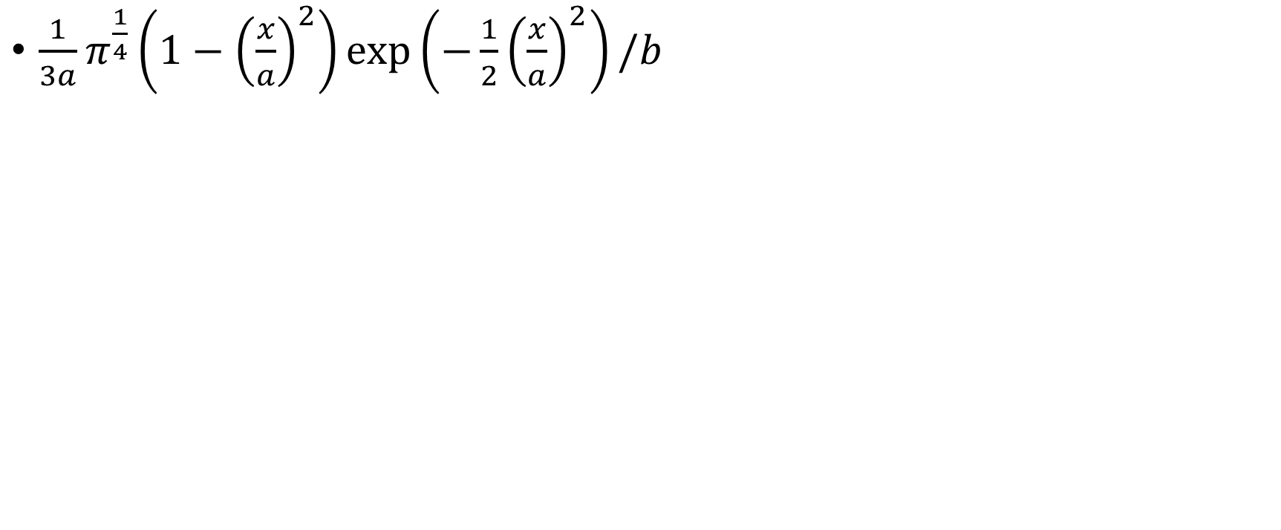


Activation function
$\frac{1}{3a}π^{\frac{1}{4}}\left(1−{\left(\frac{x}{a}\right)}^{2}\right)\exp\left(−\frac{1}{2}{\left(\frac{x}{a}\right)}^{2}\right)/b$
$$a=0.1, b=5$$
$$a=0.3, b=5$$

Slide 37
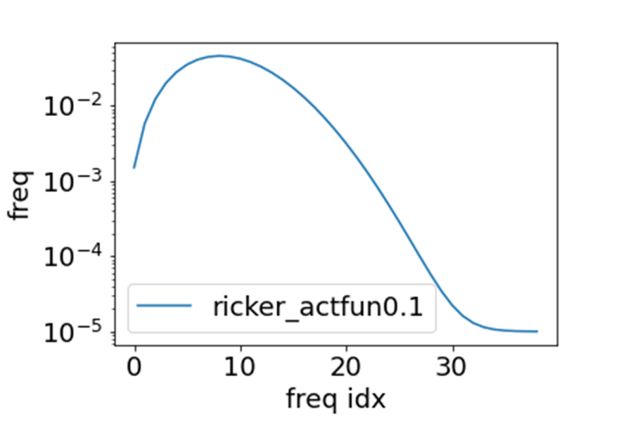
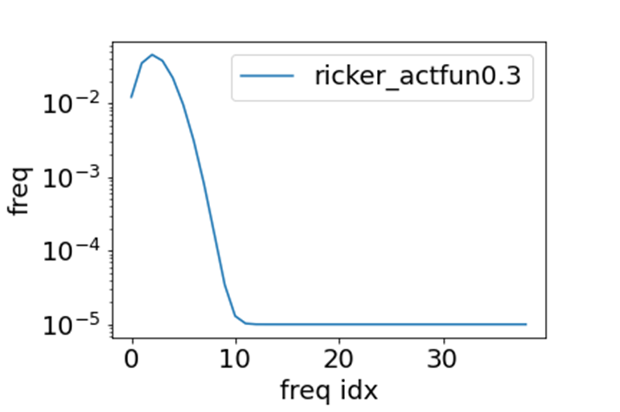
Activation function in Fourier domain
$\frac{1}{3a}π^{\frac{1}{4}}\left(1−{\left(\frac{x}{a}\right)}^{2}\right)\exp\left(−\frac{1}{2}{\left(\frac{x}{a}\right)}^{2}\right)/b$
$$a=0.1, b=5$$
$$a=0.3, b=5$$

Slide 38
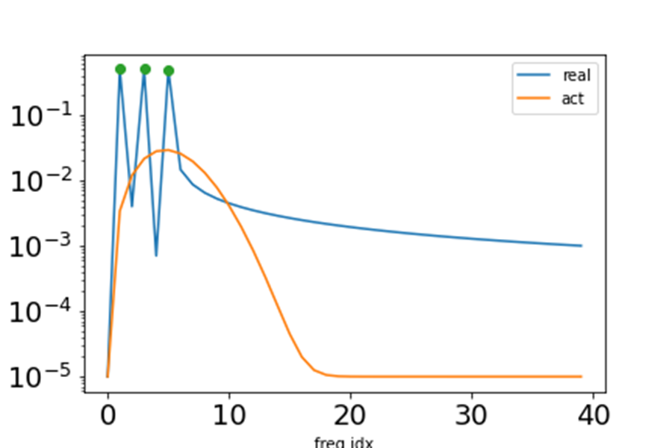
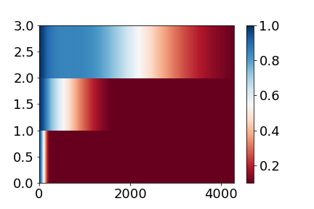
Clear Frequency principle
Low frequency faster
Relative error of three frequencies
Activation
Frequency domain
220908154157

Slide 39
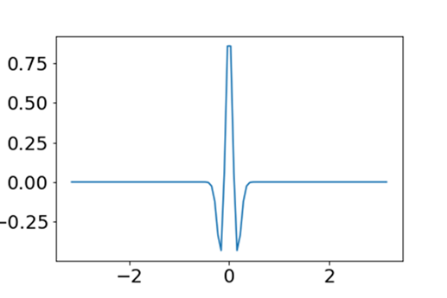
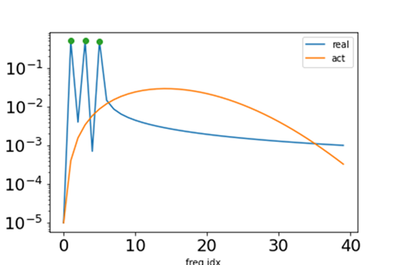

No Frequency principle
no frequency faster
Relative error of three frequencies
Activation
Frequency domain
220908154157

Slide 40
Key 1: the decay of activation in Fourier domain

Slide 41



Gradient accelerates the high-freq speed
$L_{1}=\sum{{\left(f_{θ}\left(x_{i}\right)−f^{∗}\left(x_{i}\right)\right)}^{2}}$ (Left)
$L_{2}=\sum{{\left(f_{θ}\left(x_{i}\right)−f^{∗}\left(x_{i}\right)\right)}^{2}+{\left({∇_{x}f}_{θ}\left(x_{i}\right)−∇_{x}f^{∗}\left(x_{i}\right)\right)}^{2}}$(right)
ReLU, same target
[100, 200, 100]
Adam

Slide 42

Gradient accelerates the high-freq speed
${∇_{x}f}_{θ}\left(x_{i}\right)$ in Fourier domain $ξ {\hat{f}}_{θ}(ξ)$
Equivalent to add more weight for high frequency

Slide 43
Key 2: the weight of frequency in loss function

Slide 44
Why we need frequency principle?
Zhi-Qin John Xu*, Yaoyu Zhang, Tao Luo,
Overview frequency principle/spectral bias in deep learning. arxiv 2201.07395 (2022)

Slide 45




Clear Frequency principle, flat interpolation
Low frequency faster
Activation
Frequency domain
Initial epoch
Relative error of three frequencies
Final, training points
Final, test points
Loss
Zhi-Qin John Xu*, Yaoyu Zhang, Tao Luo,
Overview frequency principle/spectral bias in deep learning. arxiv 2201.07395 (2022)
220908154157

Slide 46







no Frequency principle, oscillated interpolation
No frequency faster
Activation
Frequency domain
Initial epoch
Relative error of three frequencies
Final, training points
Final, test points
Loss
Zhi-Qin John Xu*, Yaoyu Zhang, Tao Luo,
Overview frequency principle/spectral bias in deep learning. arxiv 2201.07395 (2022)
220911183904

Slide 47







Two keys for frequency principle
Two keys!
$K_{m}$: activation
$(f_{θ}−y)$: Loss function
Luo, Ma, Xu, and Zhang, LFP , SIAM Journal on Mathematics of Data Science

Slide 48
Theory Understanding: one hidden layer, 1-d function

Slide 49



DNN: one hidden layer net
Consider a tanh-DNN of one-hidden layer for fitting a 1-d function $f$
$$h\left(x\right)=\sum_{j=1}^{m}{a_{j}σ\left(w_{j}x+b_{j}\right),}$$
$$\hat{h}\left(k\right)≈\sum_{j=1}^{m}{a_{j}\exp{(\frac{ib_{j}}{w_{j}})}\exp\left(−\left|\frac{πk}{2w_{i}}\right|\right) ,}$$
Define the loss at frequency $k$
$$L\left(k\right)=\frac{1}{2}{\left|\hat{h}\left(k\right)−\hat{f}\left(k\right)\right|}^{2}$$
By Parseval’s theorem: $L=\int{L\left(k\right)dk=∫\frac{1}{2}{\left|f\left(x\right)−h(x)\right|}^{2}dx}$
Compute the gradient by the loss in Fourier domain
$$θ←θ−η\sum{\frac{∂L\left(k\right)}{∂θ}}$$
1901.06523

Slide 50




DNN: one hidden layer net
$$\left|\frac{∂L(k)}{∂θ}\right|≈A\left(k\right)\exp\left(−\left|\frac{πk}{2w_{i}}\right|\right)G(θ,k)$$
high freq
Low freq
Where $A\left(k\right)=\left|\hat{h}\left(k\right)−\hat{f}\left(k\right)\right|$
$A\left(k\right)>0:$
If $w_{i}$ is small, $\exp{(−\left|πk/{2w}_{j}\right|)}$ dominate, low frequencies dominate.
For $w_{i}∈B_{δ}$, center at 0 with radius $δ$, if $δ$ is small, contribution of high frequency loss is negligible.
$A\left(k\right)≈0:$
small contribution from $L(k)$
Insight: smoothness/regularity of activation function $σ(⋅)$ can be converted into F-Principle through gradient-based training.
1901.06523

Slide 51
DNN: one hidden layer net
$$\left|\frac{∂L(k)}{∂θ}\right|≈A\left(k\right)\exp\left(−\left|\frac{πk}{2w_{i}}\right|\right)G(θ,k)$$
high freq
Low freq
Where $A\left(k\right)=\left|\hat{h}\left(k\right)−\hat{f}\left(k\right)\right|$
Low freq grad > high freq grad almost surely as $δ→0$.
Also can be extended to general neural network.
1901.06523

Slide 52
Linear Frequency Principle

Slide 53




Linear approximation for wide NN
$h\left(x, θ(t)\right)=h\left(x,θ_{0}\right)+∇_{θ}h(x,θ_{0})\left(θ\left(t\right)−θ_{0}\right)$ for any $t>0$
$$\frac{dθ(t)}{dt}=−∇_{θ}h{\left(X,θ_{0}\right)}^{T}\left(h\left(X,θ\left(t\right)\right)−Y\right)$$
$$L\left(θ\right)={\frac{1}{2}\left\|h\left(X,θ\right)−Y\right\|}_{2}^{2}$$
$$X:{\left[x_{i}\right]}_{i=1}^{M} Y:{\left[y_{i}\right]}_{i=1}^{M}$$
CIFAR 10, CNN
Lee et al., 2019

Slide 54







Linear F-Principle dynamics
$$\frac{dθ(t)}{dt}=−∇_{θ}h{\left(X,θ_{0}\right)}^{T}\left(h\left(X,θ\left(t\right)\right)−Y\right)$$
$$h\left(x,θ\right)=\frac{1}{\sqrt{m}}\sum_{i=1}^{m}{w_{i}σ(r_{i}(x+l_{i}))}$$
1-d function
$N$ sufficiently large
$$∂_{t} \hat{h}\left(ξ,t\right)=\left[\frac{\frac{1}{N}\sum_{i=1}^{N}{\left(r_{i}{\left(0\right)}^{2}+w_{i}{\left(0\right)}^{2}\right)}}{ξ^{4}}+\frac{4π^{2}\frac{1}{N}\sum_{i=1}^{N}{\left(r_{i}{\left(0\right)}^{2}w_{i}{\left(0\right)}^{2}\right)}}{ξ^{2}}\right]\left(\hat{f_{p}}\left(ξ,t\right)−\hat{h_{p}}\left(ξ,t\right)\right)$$
$f$: target function; ${\left(⋅\right)}_{p}=(⋅)p$,where$p\left(x\right)=\frac{1}{M}\sum_{i=1}^{M}{δ(x−x_{i})}$;
$\hat{⋅}$: Fourier transform; $ξ$: frequency
For simplicity
$$∂_{t} \hat{u}\left(ξ,t\right)=−\left[\frac{\left\langle r^{2}\right\rangle +\left\langle w^{2}\right\rangle }{ξ^{4}}+\frac{4π^{2}\left\langle r^{2}w^{2}\right\rangle }{ξ^{2}}\right]\hat{u_{p}}\left(ξ,t\right)$$
$$u(x,t)=h(x,t)−f(x)$$

Slide 55



Preference induced by LFP dynamics
$$∂_{t} \hat{h}\left(ξ,t\right)=−\left[\frac{4π^{2}\left\langle r^{2}w^{2}\right\rangle }{ξ^{2}}+\frac{\left\langle r^{2}\right\rangle +\left\langle w^{2}\right\rangle }{ξ^{4}}\right]\left(\hat{h_{p}}\left(ξ,t\right)−\hat{f_{p}}\left(ξ,t\right)\right)$$
$\min_{h∈F_{γ}}{\int{{\left[\frac{4π^{2}\left\langle r^{2}w^{2}\right\rangle }{ξ^{2}}+\frac{\left\langle r^{2}\right\rangle +\left\langle w^{2}\right\rangle }{ξ^{4}}\right]}^{−1}{\left|\hat{h}\left(ξ\right)\right|}^{2}}}dξ$
s.t. $h\left(x_{i}\right)=y_{i}$ for $i=1,⋯,n$
low frequency preference
Case 1: $ξ^{−4}$ dominant
$min\int{ξ^{4}{\left|\hat{h}\left(ξ\right)\right|}^{2}}dξ\sim min\int{{\left|h′′(x)\right|}^{2}}dξ→$ cubic spline
Case 2: $ξ^{−2}$ dominant
$min\int{ξ^{2}{\left|\hat{h}\left(ξ\right)\right|}^{2}}dξ\sim min\int{{\left|h′(x)\right|}^{2}}dξ→$ linear spline

Slide 56




Two-layer relu-NN
$$∂_{t} \hat{u}\left(ξ,t\right)=−\left[\frac{\left\langle r^{2}\right\rangle +\left\langle w^{2}\right\rangle }{ξ^{4}}+\frac{4π^{2}\left\langle r^{2}w^{2}\right\rangle }{ξ^{2}}\right]\hat{u_{p}}\left(ξ,t\right)$$
w and r are initialized by uniform distributions on [ -0.1,0.1 ] and [ -0.25,0.25 ]

Slide 57


Two-layer relu-NN
$$∂_{t} \hat{u}\left(ξ,t\right)=−\left[\frac{\left\langle r^{2}\right\rangle +\left\langle w^{2}\right\rangle }{ξ^{4}}+\frac{4π^{2}\left\langle r^{2}w^{2}\right\rangle }{ξ^{2}}\right]\hat{u_{p}}\left(ξ,t\right)$$
w and r are initialized by uniform distributions on [ -2,2]

Slide 58


High-dim case
$$∂_{t} \hat{u}\left(ξ,t\right)=−\left[\frac{\left\langle {\left|r\right|}^{2}\right\rangle +\left\langle w^{2}\right\rangle }{ξ^{d+3}}+\frac{4π^{2}\left\langle {\left|r\right|}^{2}w^{2}\right\rangle }{ξ^{d+1}}\right]\hat{u_{p}}\left(ξ,t\right)$$

Slide 59
Anti-F-Principle

Slide 60








Anti-F-Principle
$$\left|\frac{∂L(k)}{∂θ}\right|≈A\left(k\right)\exp\left(−\left|\frac{πk}{2w_{i}}\right|\right)G(θ,k)$$
Where $A\left(k\right)=\left|\hat{h}\left(k\right)−\hat{f}\left(k\right)\right|$
Gradient: Loss function endorses high frequency with high priority
Example from E et al., 2019.
Example from Lu et al., DeepXDE, 2019.
[2] Xu*, Zhang, Luo, Xiao, Ma, 1901.06523, CiCP

Slide 61




DNN can easily overfit training data with bad initialization
initial
train
test
$$σ_{j}=10$$
$$σ_{j}=0.1$$
[1] Xu*, Zhang, Xiao, 1807.01251, ICONIP

Slide 62
Frequency Principle
Beginning
Theory: regularity of activation function
Algorithms: Fast capture high-frequency
Red: FFT of target function
Blue: FFT of DNN fitting
Each frame is one training step
General theory:
Luo, Ma, Xu, Zhang, 2019
E, Ma, Wu. Science China Mathematics, 2020
Wide two-layer ReLU network:
Zhang, Xu, Luo, Ma, 2019
Basri et al., NeurIPS, 2019
Cao, Fang, Wu, Zhou, Gu. 2019
Bordelon, Canatar, Pehlevan, ICML, 2020.
Zhang, Xu, Luo, Ma, 2020
Cai., Li, Liu, PhaseDNN, SIAM J. Scientific Computing, 2019
Liu, Cai, Xu, MscaleDNN. CiCP, 2020.
Jagtap, & Karniadakis, Adaptive activation, J. Comput. Phys, 2020
Wang et al., Inverse problems, Scientific reports, 2018
Biland et al., Frequency-aware reconstruction of fluid. 2019.
Dziedzic et al., Band-limited Training for CNN, ICML, 2020
Amplitude
Understanding
Wang et al., High frequency helps explain the generalization of CNN, CVPR, 2020
You et al., Drawing Early-Bird Tickets, ICLR, 2020
Chakrabarty & Maji, The Spectral Bias of the Deep Image Prior, NeurIPS, 2019
Jin, Lu, Tang, Karniadakis, Quantifying the generalization, Neural Networks, 2019
Stamatescu, McDonnell, Diagnosing CNN, DICTA, 2018
Rabinowitz, Meta-learners’ learning dynamics are unlike learners, 2019
Zhang, Wu, Rethink Generalization, Memorization and the Spectral Bias of DNNs, 2020
Ma, Wu, E, The slow deterioration of the generalization error, MSML, 2020
Xu, Zhou, Deep frequency principle, 2020
Frequency
Xu, Zhang, Xiao, ICONIP, 2019
Xu, Zhang, Luo, Xiao, Ma, CiCP, 2019
Rahaman et al., ICML, 2019

